Slide 1





INTRODUCTION TO
PROLOG PROGRAMMING LANGUAGE
CSE425 PRESENTATION
GROUP: 06
Section: 03
GROUP MEMBERS:
NOWREN MAH JABIN KHAN (ID:2211129642)
JONAK BHOWMIK (ID:2211148042)
RYSA JANNAT (ID:2211327042)

Slide 2



01
INTRODUCTION TO PROLOG LANGUAGE:
Prolog = Programming in Logic
Very different from C, Java, Python
Uses facts, rules, and questions
Works like solving a puzzle

Slide 3






01
Background / Application Areas:
Mainly used in:
Artificial Intelligence
Natural Language Processing
Expert Systems

Slide 4

01
HISTORY:
Inventors: Alain Colmerauer & Philippe Roussel
Used in Japan’s Fifth Generation Computer Project
Created in early 1970s
Origin: France

Slide 5


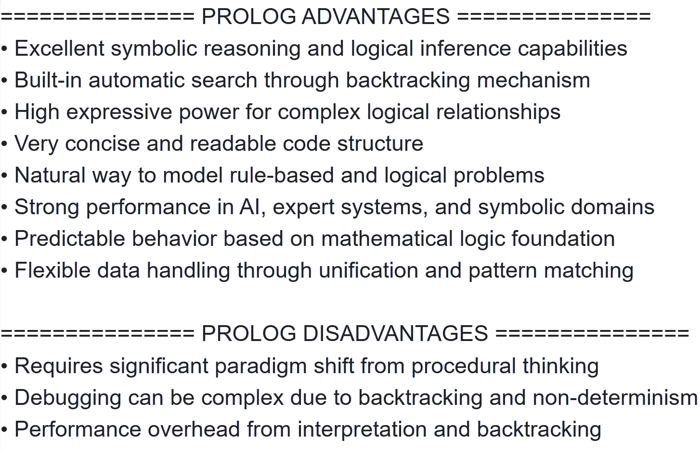
02
ADVANTAGES & DISADVANTAGES OF PROLOG

Slide 6






EVALUATION OF PROLOG FOR WRITABILITY
Natural Way To Model Problems
Built-in Automatic Search Mechanism
Flexible Handling Of Data
Concise & Compact
➢ Compact Syntax
➢ Minimal Punctuation
➢ Clear Structure
(fact and rule-based)
➢ A Declarative Language
➢ Based on Rules
➢ Has a Mathematical
Foundation
➢ Uses Backtracking
➢ Can Find Multiple
Solutions
(non-deterministic)
➢ Goal-Oriented
➢ dynamic typing
➢ Uses a Pattern-
Matching System

Slide 7




EVALUATION OF PROLOG FOR READABILITY
Natural Way To Model Problems
High Expressive Power
Significant Mental Shift To Learn
Concise & Compact
➢ Compact Syntax
➢ Minimal Punctuation
➢ Clear Structure
(fact and rule-based)
➢ A Declarative Language
➢ Based on Rules
➢ Has a Mathematical
Foundation
➢ Uses Unification
(a pattern-matching process)
➢ Uses Horn clauses
(a logical structure)
➢ Non-Procedural
Language
➢ Steep Learning Curve
➢ Need to know
Mathematical Terms

Slide 8




EVALUATION OF PROLOG FOR RELIABILITY
Symbolic Reasoning Capabilities
Predictable Behavior
High Expressive Power
Complex Debugging
➢ Uses Depth-First Search
Strategy
➢ Uses Backtracking
➢ Can Find Multiple
Solutions
(non-deterministic)
➢ A Declarative Language
➢ Logic Programming
Language
➢ Uses a Pattern-
Matching System
➢ A Declarative Language
➢ Based on Rules
➢ Has a Mathematical
Foundation
➢ Uses Unification
(a pattern-matching process)
➢ Uses Horn clauses
(a logical structure)

Slide 9




EVALUATION OF PROLOG FOR COST OF EXECUTION
Built-in Automatic Search Mechanism
Performance Overhead
➢ Uses Backtracking
➢ Can Find Multiple Solutions (non-deterministic)
➢ Goal-Oriented
➢ Uses Interpreted Execution
➢ Uses Backtracking Process
➢ Memory Intensive

Slide 10


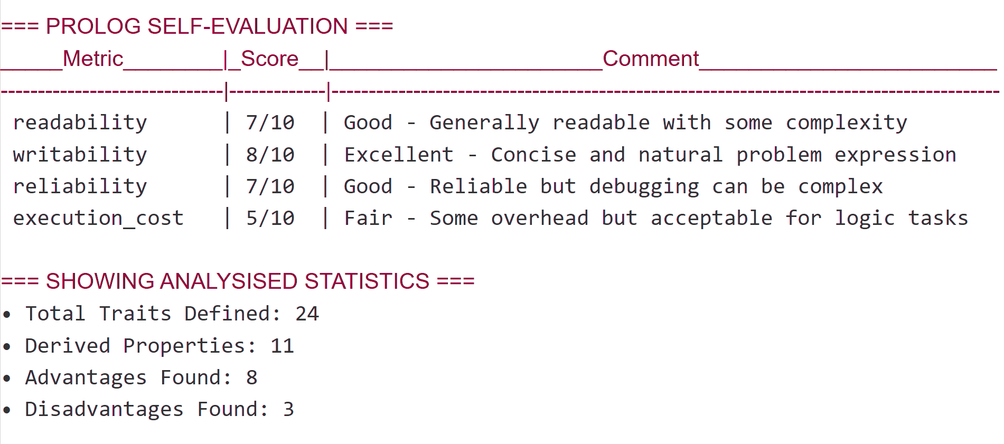
03
EVALUATION OF PROLOG

Slide 11


04
INSTALLATION PROCESS, POPULAR IDE, etc
Most popular version: SWI-Prolog
Free to download from official website
IDEs / Editors:
SWI-Prolog IDE (beginner-friendly)
VS Code (with Prolog extension)
Works on Windows, Mac, Linux

Slide 12



05
CODE EXAMPLES
trait(fundamental_facts)
...
has_property(property_1) :-
trait(fundamental_facts_1),
trait(fundamental_facts_2),
trait(fundamental_facts_3).
...
impact(property_1, positive/negative)
...
advantage/disadvantage(property_1) :-
has_property(Property_1),
impact(Property_1, positive/negative).

Slide 13


05
CODE EXAMPLES
evaluation(readability, Score, Comment) :-
findall(P, (advantage(P), affects_readability(P, positive)), PosProps),
findall(P, (disadvantage(P), affects_readability(P, negative)), NegProps),
length(PosProps, PosCount),
length(NegProps, NegCount),
BaseScore is 5 + PosCount - NegCount,
Score is max(1, min(10, BaseScore)),
format_comment(readability, Score, Comment).
...
format_comment(readability, Score, Comment) :-
number(Score),
(Score >= 8 -> Comment = 'Comment_1'
; Score >= 6 -> Comment = 'Comment_2'
; Score >= 4 -> Comment = 'Comment_3'
; Comment = 'Comment_4').
...

Slide 14

06
SPECIAL FEATURES OF PROLOG
1.Declarative Laguage: Prolog focuses on what the solution should satisfy, letting programmers emphasize logic over control flow.
2.Built-in Backtracking: Prolog auto-backtracks to try alternatives, making it ideal for search and problem-solving.
3. Rule-Based Programming: This language can define rules and relationships, and Prolog uses them to draw conclusions.
4. Unification and Pattern Matching: Prolog uses unification to match patterns, enabling powerful symbolic reasoning and data comparison.

Slide 15
064
APPLICATION DOMAINS OF PROLOG
1 . Artificial Intelligence: Widely used in expert systems, planning, and reasoning agents where logic and inference are central.
2. Natural Language Processing (NLP): Prolog helps in parsing language syntax and building chatbots or translation tools by using grammar rules.
3. Theorem Proving & Logic Solvers: Used in academic and research settings to implement logic-based proof systems and symbolic solvers.
4. Education and Research: Commonly taught in computer science curricula to introduce students to AI, logic, and non-traditional programming approaches.

Slide 16


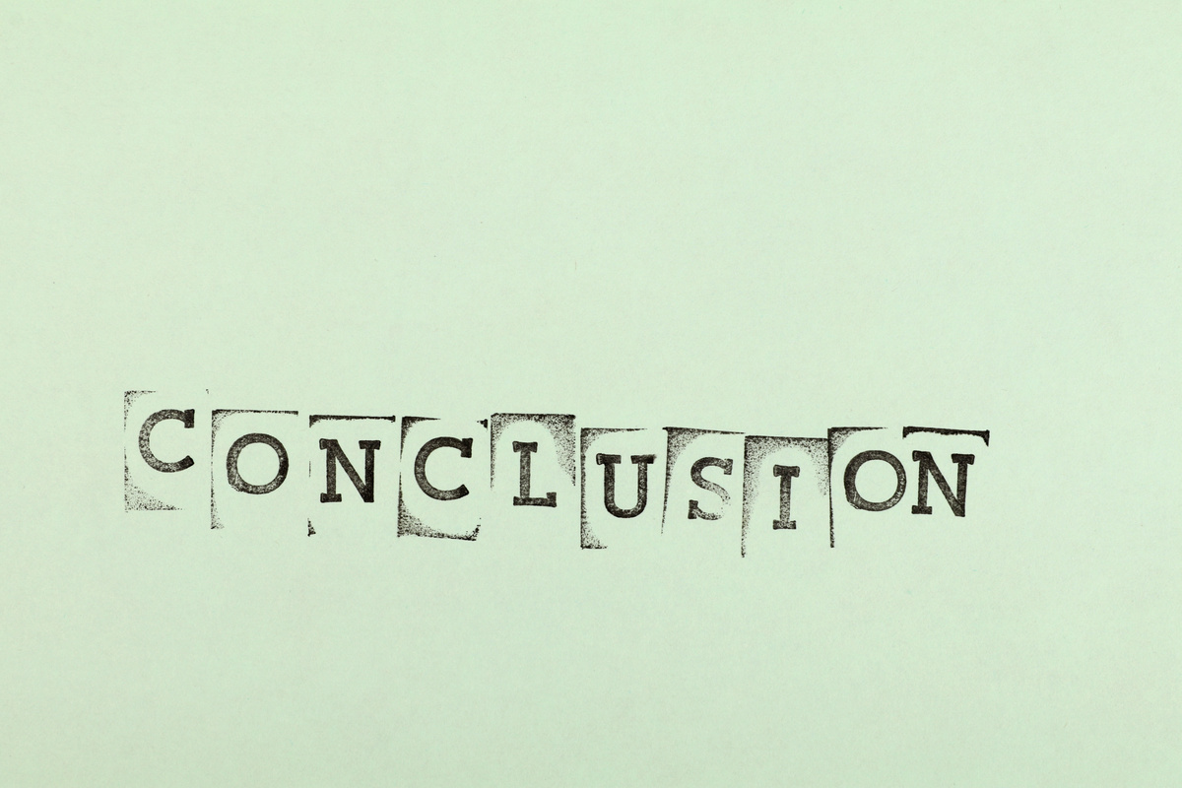
07
CONCLUSION
Prolog is a logic language that uses facts, rules, and queries for powerful reasoning.
Its backtracking and unification make Prolog ideal for AI, language processing, and symbolic computation.
Learning Prolog boosts logical thinking and is key for AI and rule-based systems.

Slide 17

07
REFERENCE AND LINKS
Books:
Bratko, Ivan. Prolog Programming for Artificial Intelligence, 4th Edition, Pearson Education, 2012.
ISBN: 978-0131386454
Links:
SWI-Prolog official site: https://www.swi-prolog.org
W3Schools - Prolog Guide: https://www.w3schools.in/prolog
GeeksforGeeks - Introduction to Prolog:https://www.geeksforgeeks.org/artificial-intelligence/prolog-an-introduction/
Prolog Code link: https://github.com/curious-JB/CSE425--PROLOG-PROGRAMMING-LANGUAGE-

